Slide 1

LECTURE 1: INTRODUCTION TO OOP & JAVA
Prepared by: Izbassar Assylzhan
Course: Object-Oriented Programming & Design – Spring 2026
Referenced from: Shamoi Pakizar

Slide 2
LECTURE 1
In this lecture, we will introduce the Object-Oriented Programming (OOP) paradigm and explore Java as an object-oriented programming language. We will discuss why OOP is used, why Java remains a popular choice, and how Java programs are compiled and executed using the Java platform.
TOPICS WE’LL COVER:
GOALS FOR THIS LECTURE:
Understand what Object-Oriented Programming is and how it differs from other programming paradigms
Why OOP?
Core OOP ideas
How Java runs?
Describe how Java programs are compiled and executed using the JVM
What is Java?
Use basic Java syntax for output, variables, and program structure
First Java program
Java Basics

Slide 3
PROGRAMMING PARADIGMS
Why OOP?
In the world of programming there exist a number of paradigms and object-oriented programming is one of them.
Core OOP ideas
Other programming paradigms include:
the imperative programming paradigm (supported by languages such as Pascal or C);
the logic programming paradigm (exemplified by Prolog, FRIL);
the functional programming paradigm (represented by languages such as ML, Haskell, Lisp, F# and Scala).
What is Java?
How Java runs?
First Java Program
What is vs How to
Java Basics
(Paradigm = way of thinking about programs)

Slide 4
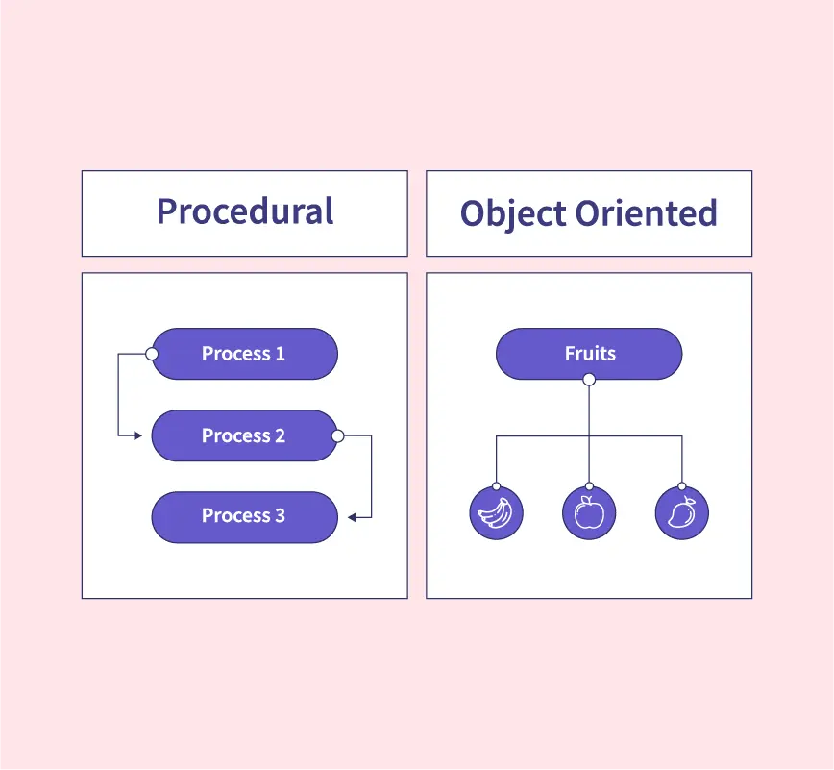
PROCEDURAL PROGRAMMING
Why OOP?
Core OOP ideas
Program = sequence of instructions
Focus on how to solve a problem
Data and functions are separate
What is Java?
How Java runs?
Sieve of Eratosthenes
First Java Program
Java Basics
Referenced from: https://www.scaler.com/topics/cpp/procedural-programming/

Slide 5
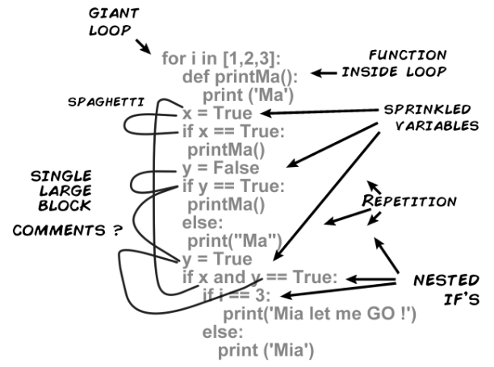
PROBLEMS OF PROCEDURAL CODE
"The object-oriented version of 'Spaghetti* code' is, of course, 'Lasagna code'. (Too many layers)."
Why OOP?
- Roberto Waltman
Core OOP ideas
What is Java?
Hard to maintain;
Hard to scale;
Hard to reuse.
How Java runs?
First Java Program
Java Basics
* Spaghetti code represents an unorganized code with no clear structure, beginning or ending.
Referenced from: https://duythinbmt.medium.com/spaghetti-code-what-is-it-and-how-we-avoid-it-34acf97e76b3

Slide 6
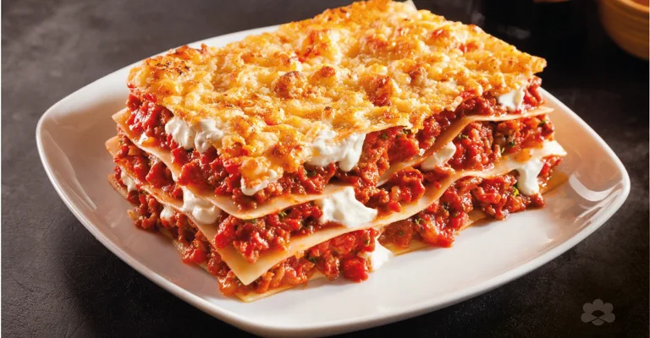
OBJECT-ORIENTED PROGRAMMING IDEA
Why OOP?
Core OOP ideas
Program = interacting objects
Focus on what the system does
Real-world modeling programming language
What is Java?
How Java runs?
First Java Program
Java Basics
Referenced from: https://www.puckarabia.com/en/recipes/easy-beef-lasagna-with-bechamel-sauce/

Slide 7
CORE OOP IDEAS

Slide 8
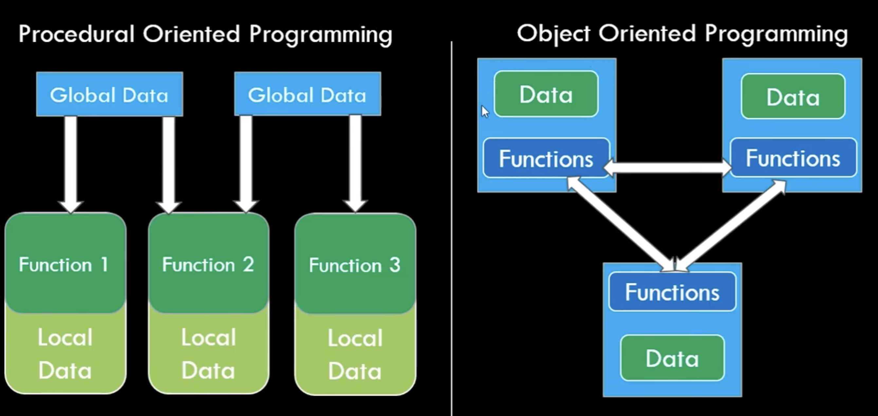
WHAT IS AN OBJECT?
An object-oriented program is seen as a community of interacting agents called objects.
Why OOP?
Core OOP ideas
What is Java?
Has state (data);
Has behavior (methods);
Has responsibility;
How Java runs?
First Java Program
Java Basics

Slide 9
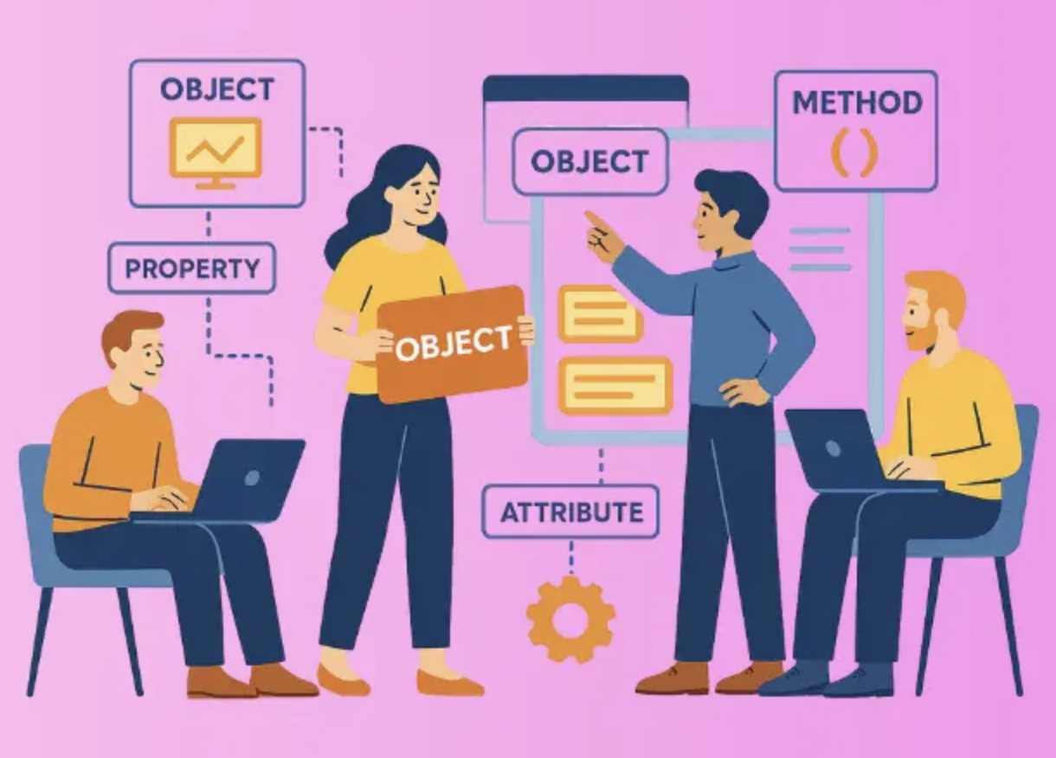
OBJECTS INTERACTION
Why OOP?
Each object has a role to play. It has some state and behavior. Each object provides a service or performs an action used by other members of the community.
Core OOP ideas
Objects send messages;
Objects use services of other objects;
System = community of objects.
What is Java?
How Java runs?
First Java Program
Java Basics
Referenced from: https://reliasoftware.com/blog/what-is-object-oriented-programming-oop

Slide 10
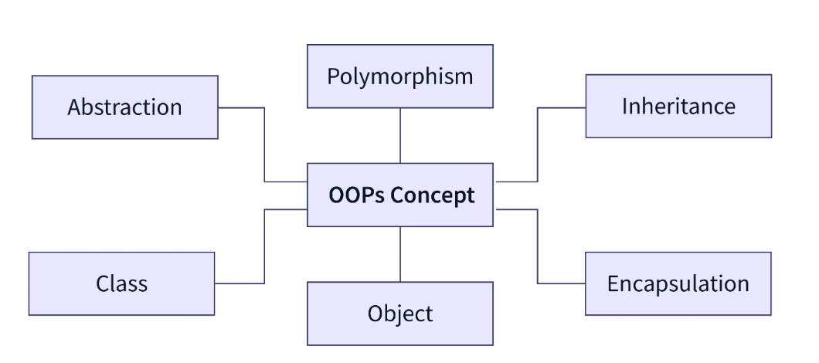
OOP PRINCIPLES (OVERVIEW)
Why OOP?
Core OOP ideas
What is Java?
How Java runs?
First Java Program
(Detailed later in course)
Java Basics
Referenced from: https://www.scaler.com/topics/cpp/procedural-programming/

Slide 11
WHAT IS JAVA?

Slide 12
WHAT IS JAVA?
Why OOP?
Java is a general‐purpose object‐oriented language. It is intended to let application developers "write once, run anywhere"
Core OOP ideas
What is Java?
Java applications are typically compiled to bytecode (class file) that can run on any Java Virtual Machine (JVM) regardless of computer architecture.
How Java runs?
First Java Program
General-purpose language;
Object-oriented;
Platform-independent.
Java Basics

Slide 13
WHY JAVA?
Why OOP?
Strong ecosystem;
Used in industry & academia.
Core OOP ideas
Simple (the language itself)
Object oriented
focus on the data (objects) and methods manipulating the data
all functions are associated with objects
almost all datatypes are objects (files, strings, etc.)
Portable
same application runs on all platforms
Dynamic Memory Management
garbage collection
What is Java?
How Java runs?
First Java Program
Java Basics

Slide 14
JAVA KEY FEATURES
Reliable
extensive compile-time and runtime error checking (e.g. bytecode cheking)
no pointers but real arrays. Memory corruptions or unauthorized memory accesses are impossible
automatic garbage collection tracks objects usage over time
Interpreted
java compiler generate byte-codes, not native machine code
the compiled byte-codes are platform-independent
java bytecodes are translated on the fly to machine readable instructions in runtime (Java Virtual Machine)
Network Support
Secure
usage in networked environments requires more security
memory allocation model is a major defense
access restrictions are forced (private, public)
array access bounds checking
Multithreaded
multiple concurrent threads of executions can run simultaneously
Dynamic
java is designed to adapt to evolving environment
libraries can freely add new methods and instance variables without any effect on their clients
interfaces promote flexibility and reusability in code by specifying a set of methods an object can perform, but leaves open how these methods should be implemented
Why OOP?
Core OOP ideas
What is Java?
How Java runs?
First Java Program
Java Basics

Slide 15
HOW JAVA RUNS

Slide 16
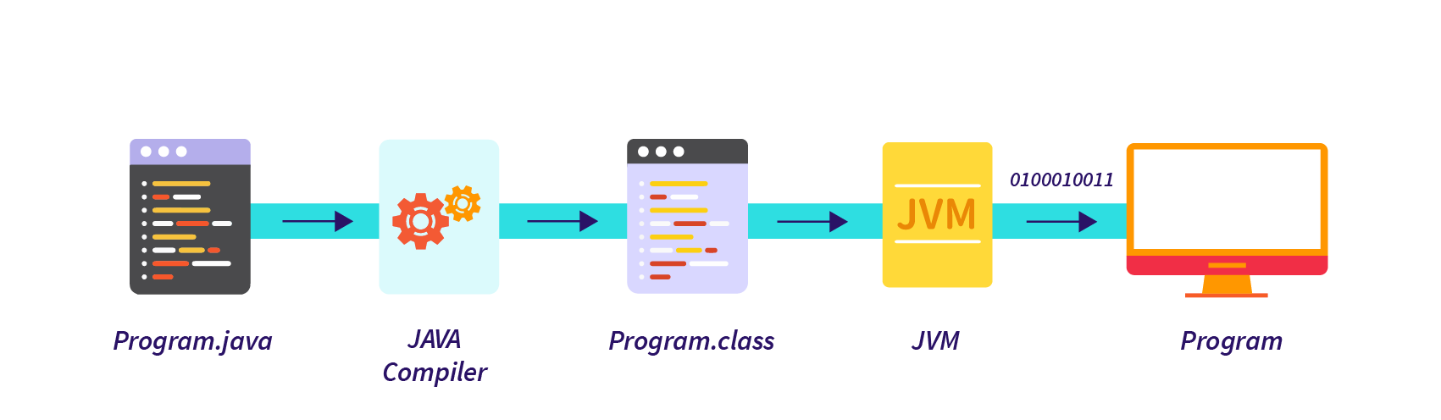
JAVA EXECUTION MODEL
Why OOP?
.java → .class → JVM - Source code - Bytecode - Execution
Core OOP ideas
What is Java?
How Java runs?
First Java Program
Java Basics
Referenced from: https://www.scaler.com/topics/cpp/procedural-programming/

Slide 17
BYTECODE
Why OOP?
Core OOP ideas
Platform-independent
Not native machine code
Designed for JVM
What is Java?
How Java runs?
First Java Program
Java Basics

Slide 18
JAVA VIRTUAL MACHINE (JVM)
Why OOP?
Core OOP ideas
Software for a platform;
Interprets bytecode;
Enables portability.
What is Java?
How Java runs?
First Java Program
Java Basics

Slide 19
JRE vs JVM
Why OOP?
Core OOP ideas
JVM = execution engine;
JRE = JVM + libraries.
What is Java?
How Java runs?
First Java Program
Java Basics

Slide 20
PERFORMANCE NOTES
Why OOP?
Core OOP ideas
Slower than native code;
JIT compilation;
Security checks.
What is Java?
How Java runs?
First Java Program
Java Basics

Slide 21
FIRST JAVA PROGRAM

Slide 22
STRUCTURE OF A JAVA PROGRAM
Why OOP?
Core OOP ideas
Class;
main method;
Statements.
What is Java?
How Java runs?
First Java Program
Java Basics

Slide 23

main METHOD
Why OOP?
Core OOP ideas
Program entry point - JVM starts execution here
What is Java?
How Java runs?
First Java Program
Java Basics

Slide 24
COMPILATION & EXECUTION
Why OOP?
Core OOP ideas
javac → compiler;
java → interpreter.
What is Java?
How Java runs?
First Java Program
Java Basics

Slide 25
CONSOLE OUTPUT
Why OOP?
Core OOP ideas
System.out.print();
System.out.println();
\n new line.
What is Java?
How Java runs?
First Java Program
Java Basics

Slide 26
COMMENTS
Why OOP?
Core OOP ideas
// single-line
/ multi-line /
/* documentation /
What is Java?
How Java runs?
First Java Program
Java Basics

Slide 27
JAVA BASICS

Slide 28
VARIABLES
Why OOP?
Core OOP ideas
Store values;
Must be declared.
What is Java?
How Java runs?
First Java Program
Java Basics

Slide 29
DATA TYPES
Why OOP?
Core OOP ideas
Primitive types;
Reference types.
What is Java?
(Objects vs values)
How Java runs?
First Java Program
Java Basics

Slide 30
OPERATORS & CONSTANTS
Why OOP?
Core OOP ideas
Arithmetic operators;
Shortcut operators;
Constants: final.
What is Java?
How Java runs?
First Java Program
Java Basics

Slide 31
STRUCTURE & CONTROL

Slide 32
CONTROL FLOW
Why OOP?
Core OOP ideas
Selection (if, switch);
Loops (for, while).
What is Java?
How Java runs?
First Java Program
Java Basics

Slide 33
METHODS
Why OOP?
Core OOP ideas
Group logic;
Reuse code;
Abstraction (black box).
What is Java?
How Java runs?
First Java Program
Java Basics

Slide 34
PROGRAMMING ERRORS
Why OOP?
Core OOP ideas
Syntax errors;
Runtime errors;
Logic errors.
What is Java?
How Java runs?
First Java Program
Java Basics

Slide 35
PROGRAMMING STYLE
Why OOP?
Core OOP ideas
Meaningful names;
Proper indentation;
Comments.
What is Java?
How Java runs?
First Java Program
Java Basics

Slide 36
SUMMARY & NEXT STEPS
Why OOP?
Core OOP ideas
OOP mindset;
Java platform;
Basic syntax;
Next lecture: deeper OOP & classes.
What is Java?
How Java runs?
First Java Program
Java Basics

Slide 37
Q & A

